Slide 1
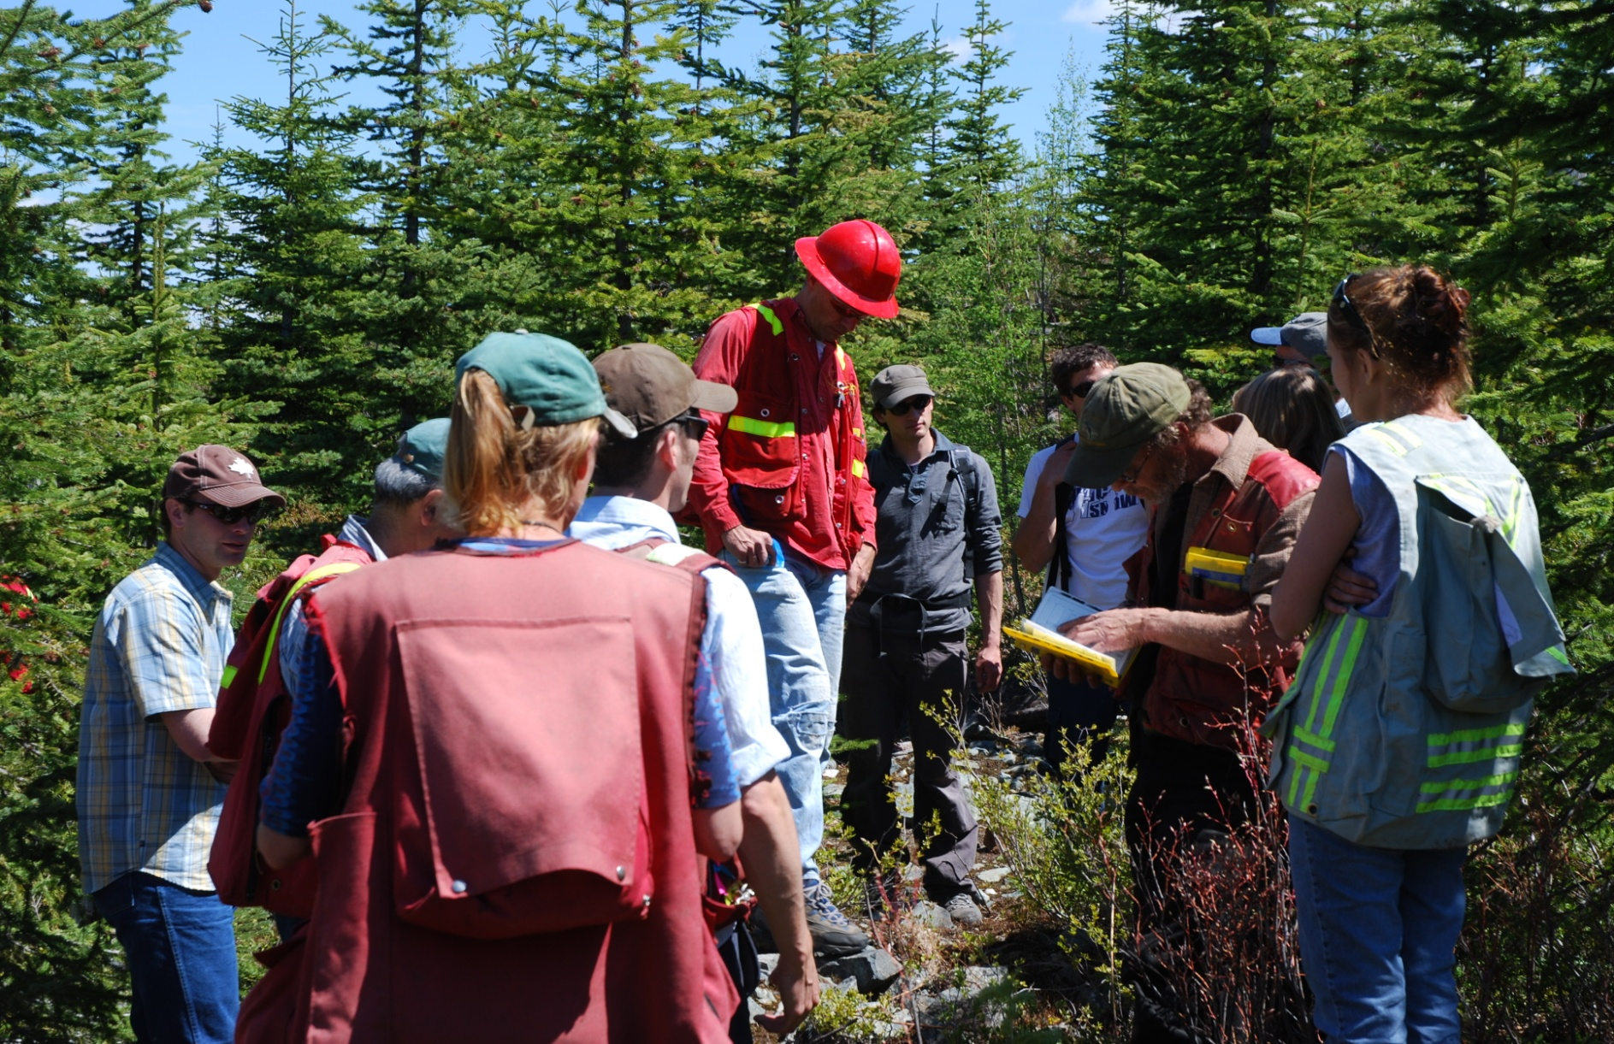

Stand Development Monitoring
Harry Kope
Resource Practices Branch

Slide 2
What SDM is................
  It’s a point-in-time assessment......
  It’s a ‘mid-rotation’ (ages 20 to 40) survey that collects data on pest incidence and stocking......
What SDM collects................
  Polygon size, tree age and BEC information...........
  Total live and dead tree by species, by layer..............
  Forest Health factors on live and dead trees..............
  Height and DBH of layer 1 and layer 2 trees..........
  Site index using growth intercept..........
  Inventory label..........

Slide 3
SDM collections so far.........
TSA
100 Mile House (29)
Boundary (29)
Bulkley (19)
Cranbrook (29)
Fort Nelson (6)
Fraser (17)
Golden (30)
Invermere (10)
Kamloops (49)
Kingcome (2)
Lakes (14)
Mackenzie (30)
Merritt (22)
Morice (8)
Prince George (71)
Quesnel (35)
Queen Charlotte Islands (2)
Revelstoke (7)
Strathcona (5)
Sunshine Coast (14)
Williams Lake (76)
21 TSA’s
504 openings
Collected from 2009 to 2013

Slide 4
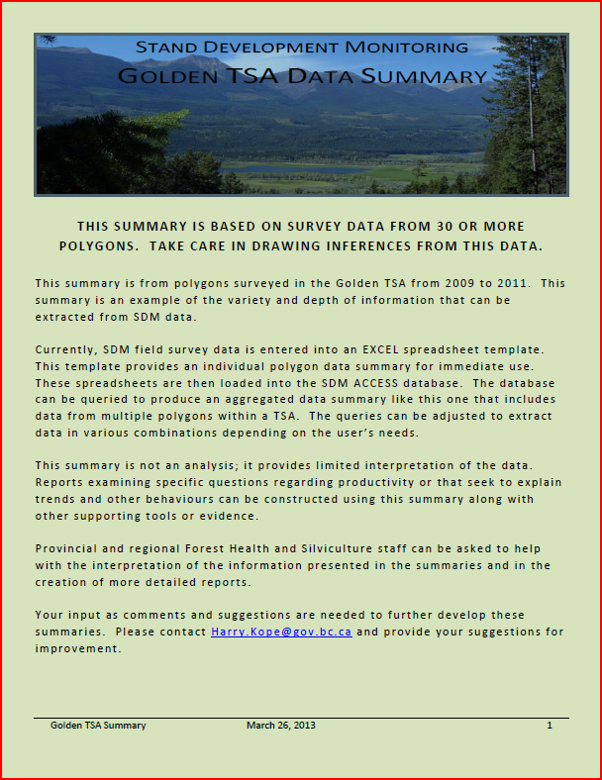
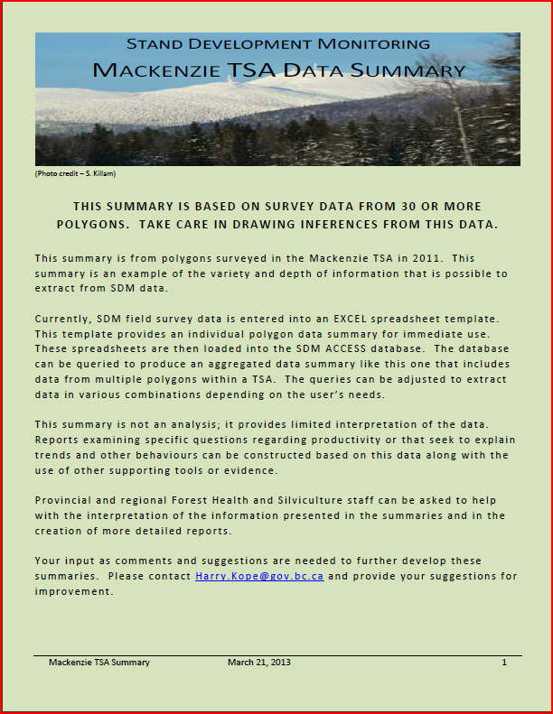
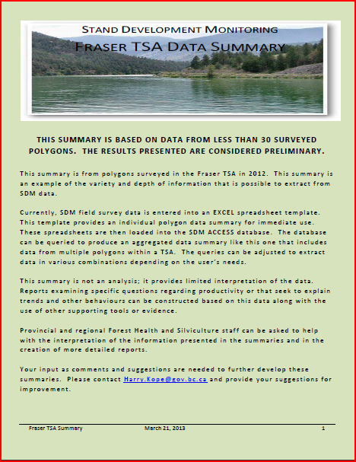
Where is the SDM data?
https://spc-flnr.gov.bc.ca/frep/FREP%20data/Forms/AllItems.aspx?RootFolder=%2Ffrep%2FFREP%20data%2FSDM%2FSDM%20field%20data%20by%20TSA&FolderCTID=0x012000DBA9C8AAFEB3E144A5A407625D5ABE3A&View=%7b0A141741-A7D0-4903-A4B5-504480C083FD%7d
OR
TSA data summaries
Examples
  Fraser
  Golden
  Mackenzie

Slide 5
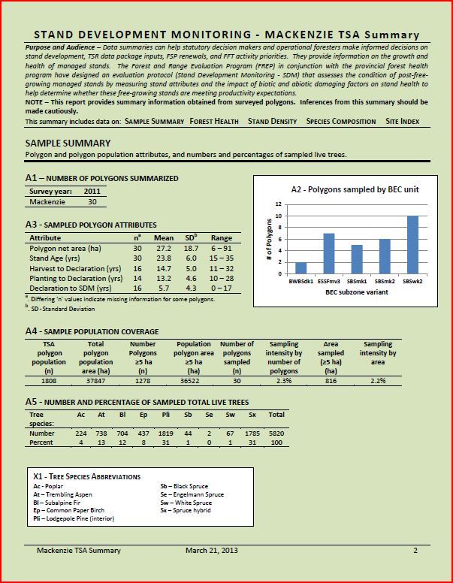
Sample
Summary

Slide 6
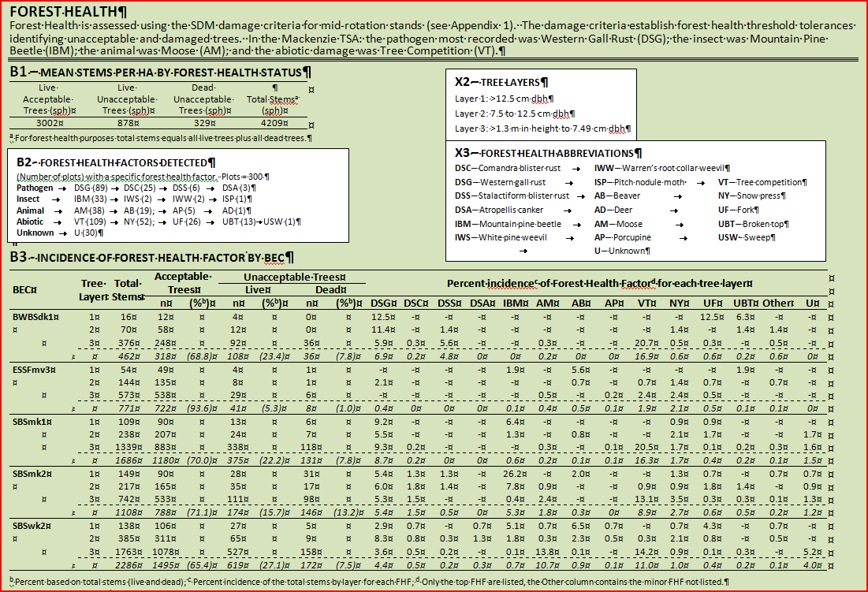
Forest
Health

Slide 7
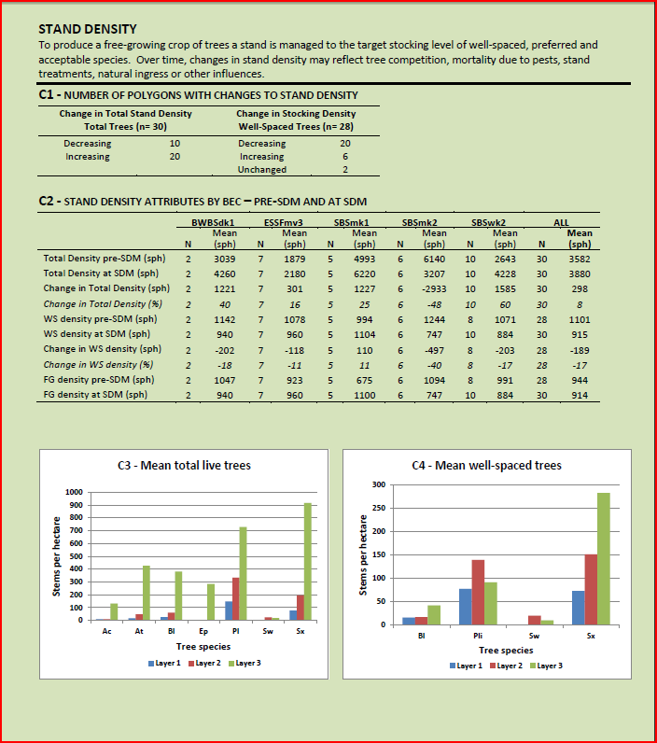
Stand
Density

Slide 8
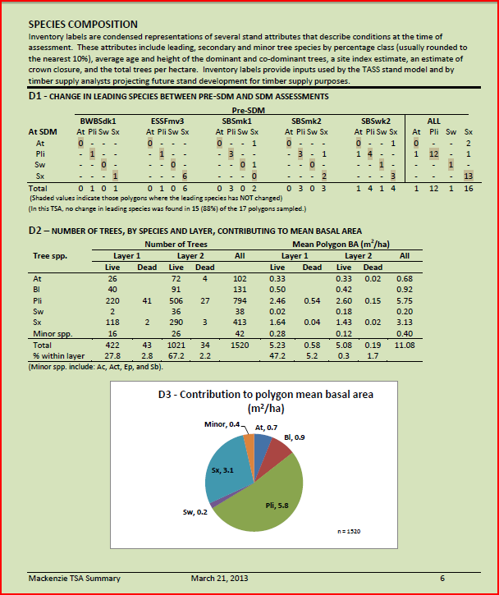
Species
Composition
26 (87%) of 30 polygons sampled)

Slide 9
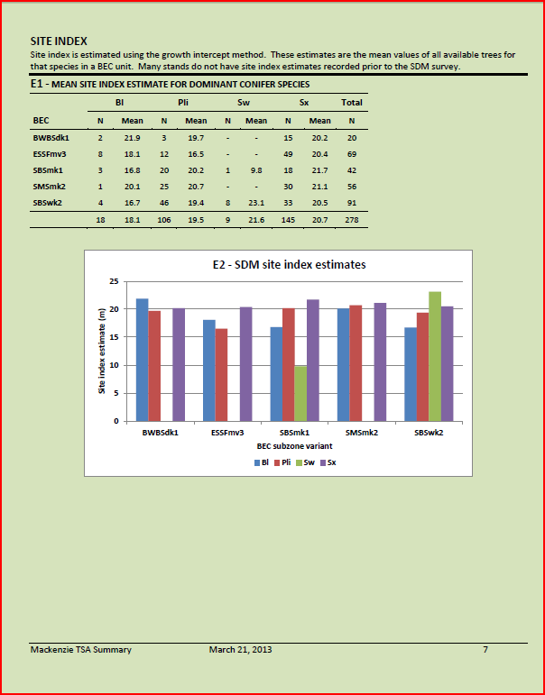
Site
Index

Slide 10
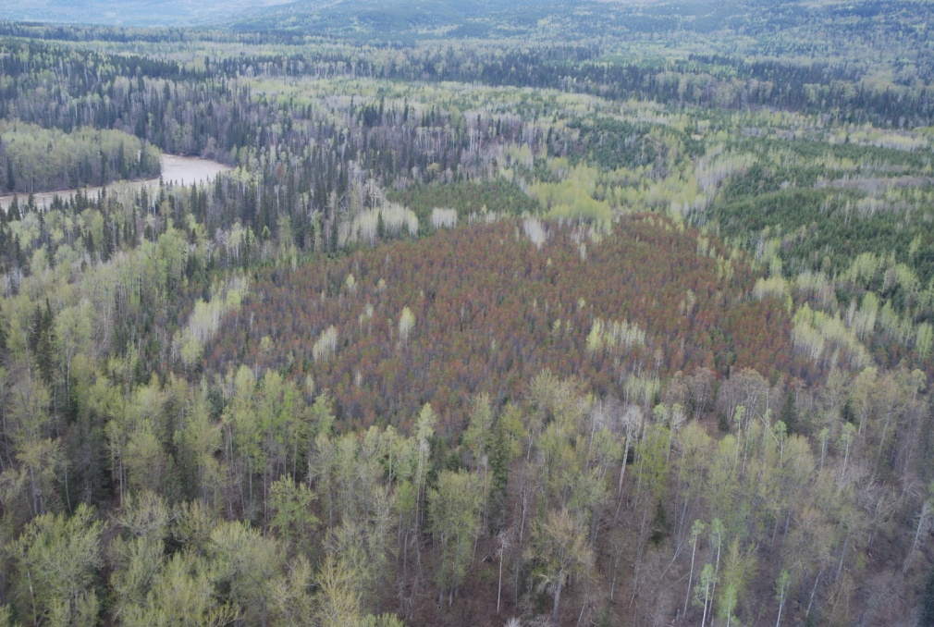
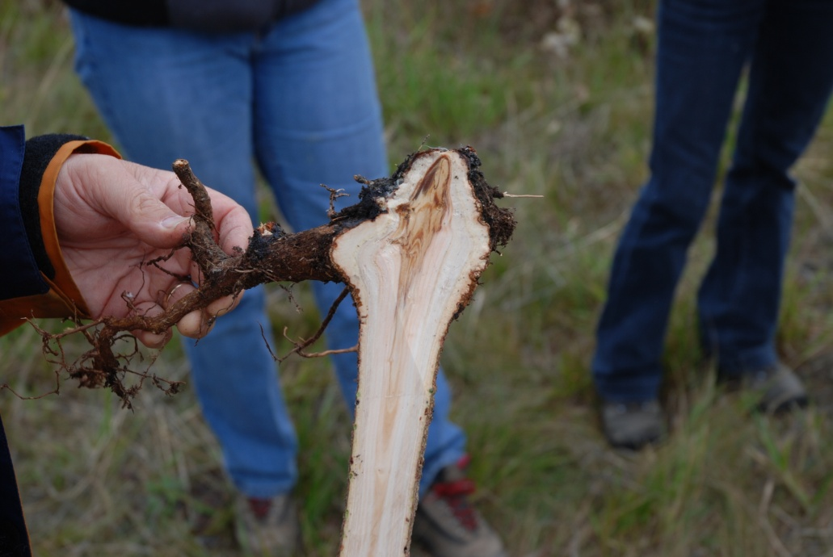
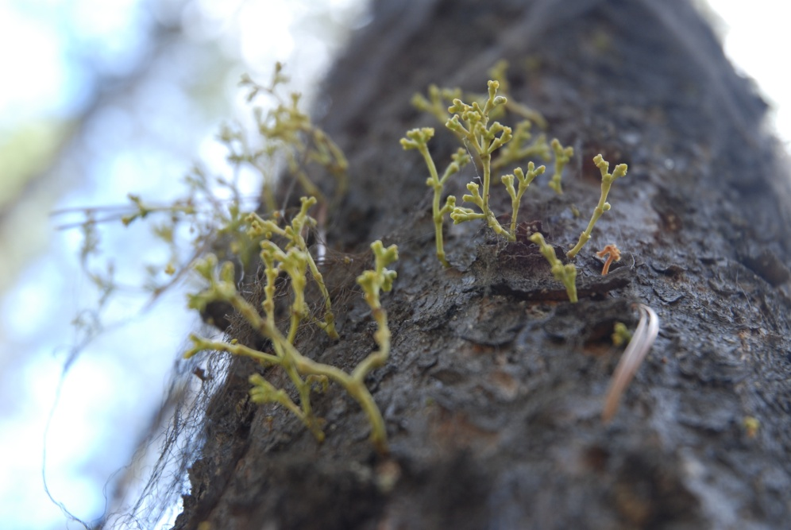

Slide 11
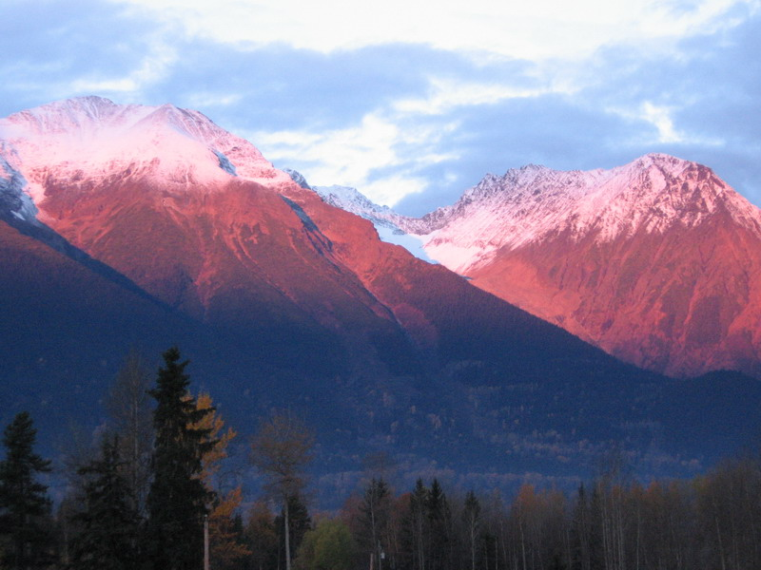
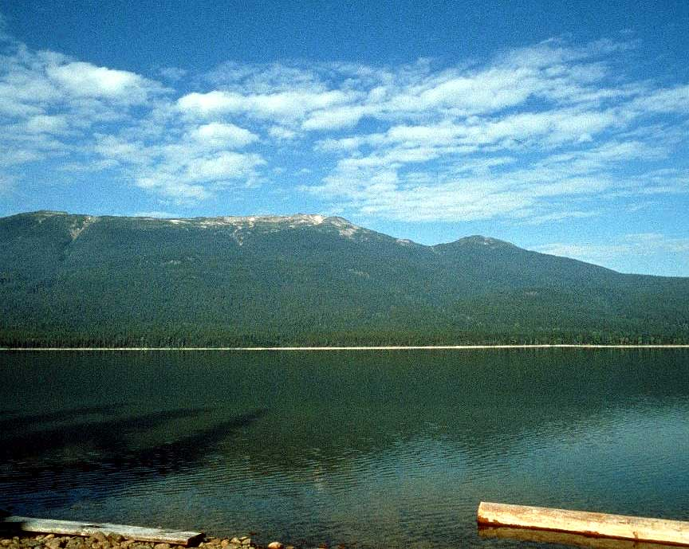
SDM “roll-ups”
TSA’s
100 Mile House (29)
Bulkley (19)
Lakes (14)
Mackenzie (30)
Morice (8)
Prince George (71)
Quesnel (35)
Williams Lake (76)
Polygon attributes
Mean age (yrs) - 25
Range of ages – 15 to 50
Net area (ha) - 33
Range of net area – 6 to 91
N= 282

Slide 12
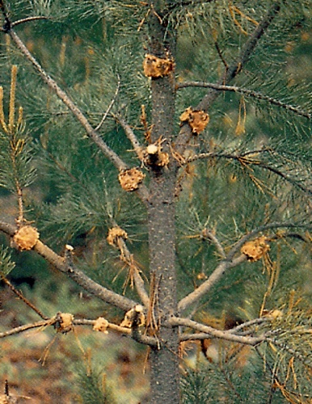
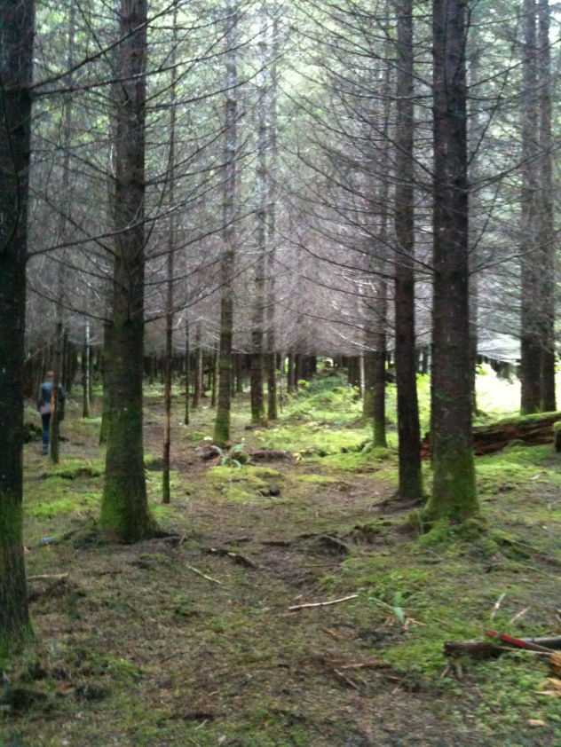
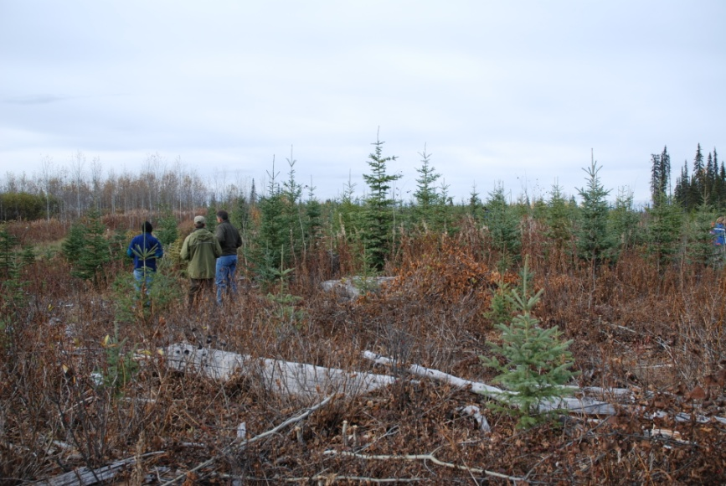
Forest Health
Top 5 Forest Health issues
Suppression (Veg. competition)
Western gall rust
Fork
Moose
Snow Press
Forest Health issues
Abiotic
Animal
Insect
Rusts

Slide 15
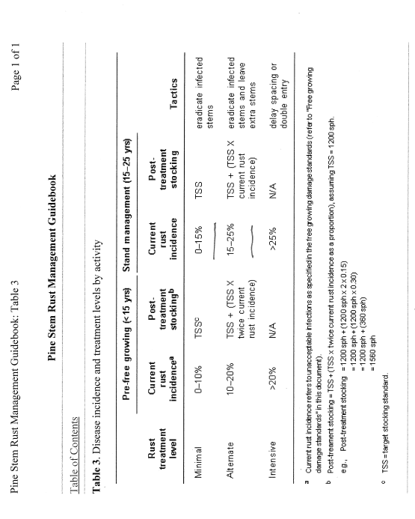
19
27
15
51
145

Slide 16
Approx 73% of the total trees are in layer 3

Slide 18
Basal Area – mean polygon basal area (m2/ha)
Quesnel

Slide 19
The benefits of a ‘point-in-time’ assessment at mid-rotation
  Assess forest health...........
    Identify the major and minor forest health factors
    Determine where forest health factors are occurring (BEC)
    Determine on what species of tree forest health factors are occurring
    A count and/or percentage of live and dead trees
  Track how stand attributes change in managed forests...........
    Identifying stand composition by layer
    Identify current Basal area
  Data supplied to other databases. i.e., RESULTS.............
    Changes to the Inventory label
    SDM data could ultimately be used to support revision of standards associated with current practices......

Slide 20
FFT and SDM - interactions
FFT surveyed a stand that was to be surveyed by SDM. However, RESULTS was not updated so the SDM crew didn’t know that the polygon boundaries changed.
This remapping and making changes in RESULTS makes it difficult for SDM to match historical to current stand data
FFT and SDM - opportunities
FFT and SDM activities should be co-ordinated within districts so that overlapping surveys and competing data do not occur.
FFT could consider using SDM data of common openings (better than aerial surveys).
FFT should consider funding SDM surveys where on-the-ground data collection is important and openings are shared.

Slide 21

Questions?
Comments?
Constructive
criticism?
SDM team
Kevin Astridge, Frank Barber, Harry Kope, Dave Weaver, Stefan Zeglen (team lead)

